Slide 1

Slides developed by Mine Çetinkaya-Rundel of OpenIntro
Translated from LaTeX to Google Slides by Curry W. Hilton of OpenIntro.
The slides may be copied, edited, and/or shared via the CC BY-SA license
To make a copy of these slides, go to File > Download as > [option], as shown below. Or if you are logged into a Google account, you can choose Make a copy... to create your own version in Google Drive.

Slide 2
Chi-Square Test of Independence

Slide 3
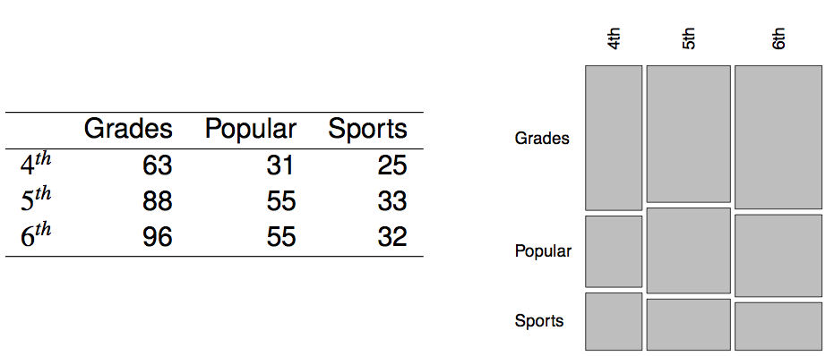
Popular kids
In the dataset popular, students in grades 4-6 were asked whether good grades, athletic ability, or popularity was most important to them. A two-way table separating the students by grade and by choice of most important factor is shown below. Do these data provide evidence to suggest that goals vary by grade?

Slide 4
Chi-square test of independence
The hypotheses are:
H₀: Grade and goals are independent. Goals do not vary by grade.
H_{A}: Grade and goals are dependent. Goals vary by grade.

Slide 5
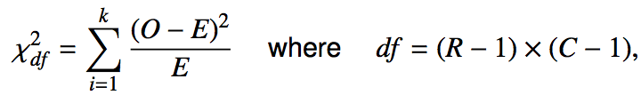
Chi-square test of independence
The hypotheses are:
H₀: Grade and goals are independent. Goals do not vary by grade.
H_{A}: Grade and goals are dependent. Goals vary by grade.
The test statistic is calculated as
where k is the number of cells, R is the number of rows, and C is the number of columns.
_______________
Note: we calculate df differently for one-way and two-way tables.

Slide 6
Chi-square test of independence
The hypotheses are:
H₀: Grade and goals are independent. Goals do not vary by grade.
H_{A}: Grade and goals are dependent. Goals vary by grade.
The test statistic is calculated as
where k is the number of cells, R is the number of rows, and C is the number of columns.
_______________
Note: we calculate df differently for one-way and two-way tables.
The p-value is the area under the χ²_{df} curve, above the calculated test statistic.

Slide 7

Expected counts in two-way tables

Slide 8
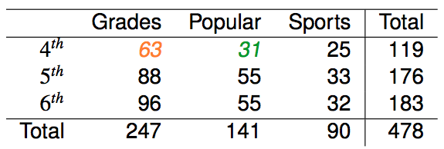
Expected counts in two-way tables

Slide 9

Expected counts in two-way tables

Slide 10

Expected counts in two-way tables

Slide 11
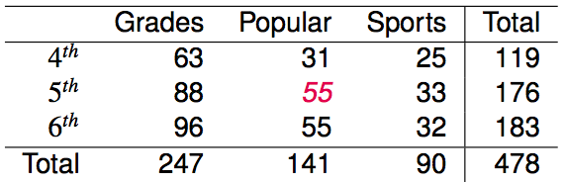
Expected counts in two-way tables
What is the expected count for the highlighted cell?
176 x 141 / 478
119 x 141 / 478
176 x 247 / 478
176 x 478 / 478

Slide 12
Expected counts in two-way tables
What is the expected count for the highlighted cell?
176 x 141 / 478
119 x 141 / 478
176 x 247 / 478
176 x 478 / 478
→ 52
more than expected # of 5th graders
have a goal of being popular

Slide 13
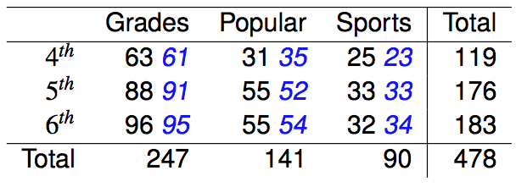
Calculating the test statistic in two-way tables
Expected counts are shown in blue next to the observed counts.

Slide 14

Calculating the test statistic in two-way tables
Expected counts are shown in blue next to the observed counts.

Slide 15
Calculating the test statistic in two-way tables
Expected counts are shown in blue next to the observed counts.

Slide 16
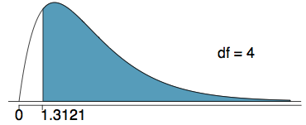
Calculating the p-value
Which of the following is the correct p-value for this hypothesis test?
χ²_{df} = 1.3121 df = 4
more than 0.3
between 0.3 and 0.2
between 0.2 and 0.1
between 0.1 and 0.05
less than 0.001

Slide 17
Calculating the p-value
Which of the following is the correct p-value for this hypothesis test?
χ²_{df} = 1.3121 df = 4
more than 0.3
between 0.3 and 0.2
between 0.2 and 0.1
between 0.1 and 0.05
less than 0.001

Slide 18
Conclusion
Do these data provide evidence to suggest that goals vary by grade?
H₀: Grade and goals are independent. Goals do not vary by grade.
H_{A}: Grade and goals are dependent. Goals vary by grade.

Slide 19
Conclusion
Do these data provide evidence to suggest that goals vary by grade?
H₀: Grade and goals are independent. Goals do not vary by grade.
H_{A}: Grade and goals are dependent. Goals vary by grade.
Since the p-value is large, we fail to reject H₀.The data do not provide convincing evidence that grade and goals are dependent. It doesn't appear that goals vary by grade.

Slide 20
Find more resources at openintro.org/os, including
Slides
Videos
Statistical Software Labs
Discussion Forums (free support for students and teachers)
Learning Objectives
Teachers only content is also available for Verified Teachers, including
Exercise solutions
Sample exams
Ability to request a free desk copy for a course
Statistics Teachers email group
Questions? Contact us.

Slide 21
Extra Slides from the OS3 section on chi-square test of independence

Slide 22
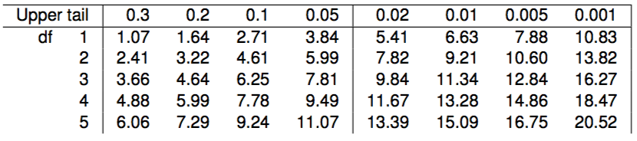
Calculating the p-value
Which of the following is the correct p-value for this hypothesis test?
χ²_{df} = 1.3121 df = 4
more than 0.3
between 0.3 and 0.2
between 0.2 and 0.1
between 0.1 and 0.05
less than 0.001

Slide 23
Calculating the p-value
Which of the following is the correct p-value for this hypothesis test?
χ²_{df} = 1.3121 df = 4
more than 0.3
between 0.3 and 0.2
between 0.2 and 0.1
between 0.1 and 0.05
less than 0.001

